Slide 1
9 Ways to think about what to do with technology in teaching English HKEdCity Teaching and Learning Expo: 16 July 2010
Dr Paul Sze
Dept of Curriculum & Instruction
CUHK

Slide 2
CALL

Slide 3
CBLL ?

Slide 4
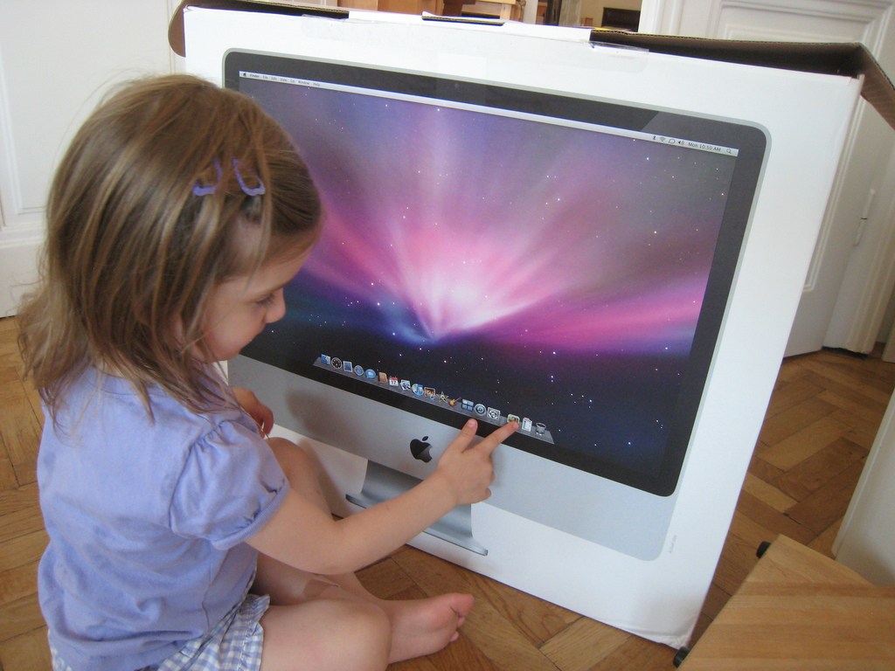

Slide 11
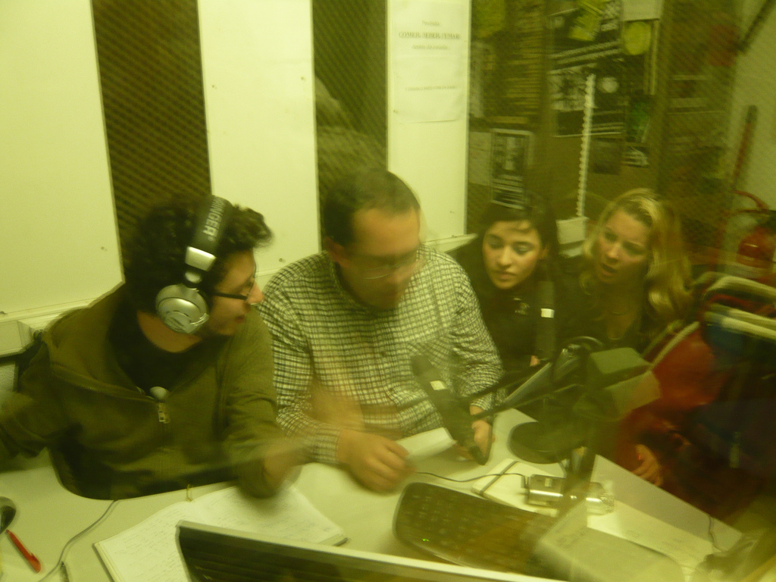

Slide 13
9 ways to think about …
What to do with technology in English Language teaching

Slide 14
1. Skill-oriented
Listening?
Speaking?
Reading?
Writing?
Combination?
Eg., reading and writing: wikis

Slide 15
2. Unit-theme based?
Programme-based?

Slide 16
3. Tool-oriented
Blogging; podcasting; wikis; Skype; Voicethreads; Hot Potatoes …

Slide 17
4. Activity-oriented
Radio drama; digital storytelling; Webquests; electronic portfolios; etc.

Slide 18
5. Teacher-led?
Self-access?

Slide 19
6. Resources-focussed
eBooks; ELT software; learning materials on the Web; etc.

Slide 20
7. Individualised?
Collaborative?

Slide 21
8. Accuracy-focused?
Fluency-focused?

Slide 22
9. Enrichment?
Remedial?

Slide 23
Prospects, prospects, prospects…

Slide 24
Thank you!
paulsze@cuhk.edu.hk

