Slide 1
從Coding 到 STEM
Leading School: 樂善堂梁銶琚學校分校

Slide 2
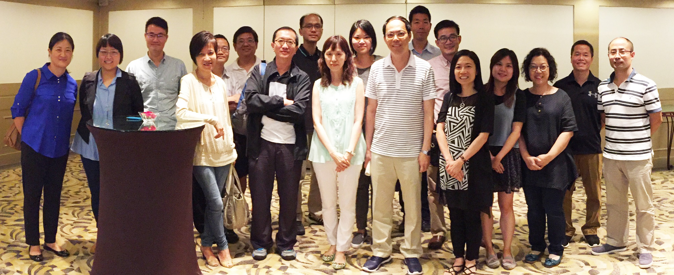
Dept. of Curriculum & Instruction 課程與教學學系

Slide 3
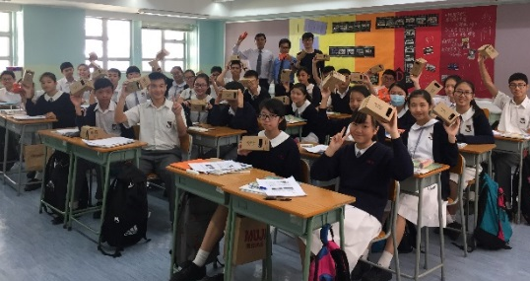
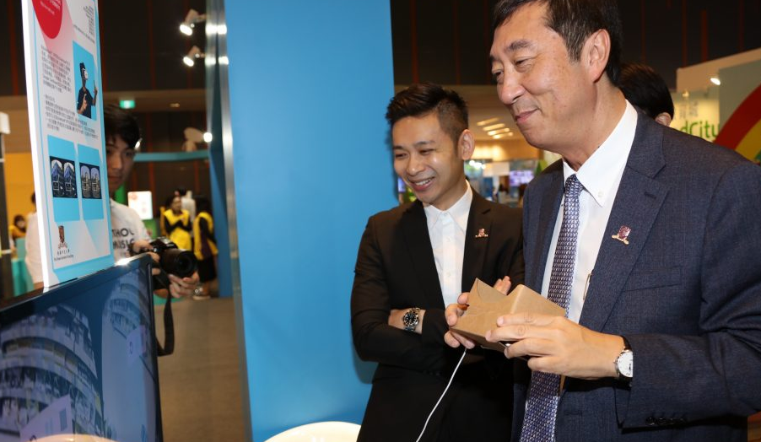
Ctr. for Learning Sciences & Technologies 學習科學與科技中心
Teacher Development
Flipped Classroom
Mobile Learning
STEM
……

Slide 4
Why STEM …
Gov? $100K? $200K?

Slide 5
Are you aware of the PISA results? 3 areas?
Programme for International Student Assessment
學生能力國際評估計劃
OECD: 經濟合作發展組織

Slide 7
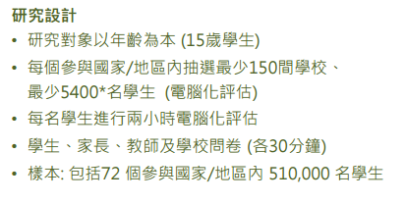
OECD PISA 2015 (72 countries and regions)

Slide 8
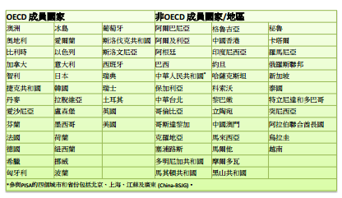

Slide 9
OECD PISA 2015 (72 countries and regions)

Slide 10
Critique …
Why we need to change …

Slide 12
OECD PISA 2015 (72 countries and regions)
How many Nobel-Prize winners are
from these countries/regions?

Slide 13
Lack what …?

Slide 14
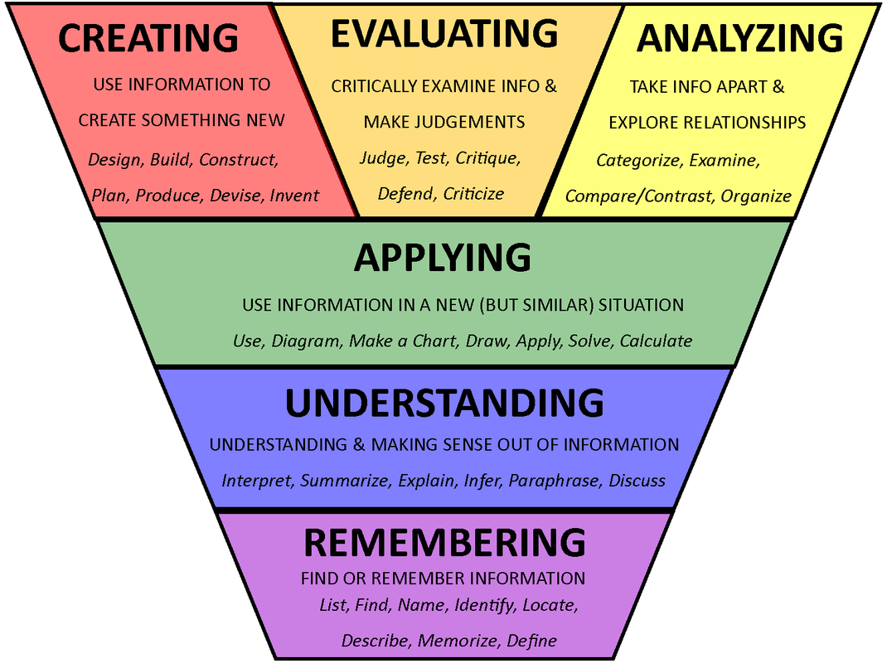
Higher-order Thinking
Image extracted from http://melanielinktaylor.mzteachuh.org/2015_10_11_archive.html
Notes:
This is the Bloom’s Taxonomy, which is a very well-known framework in the field of education to guide teachers to design learning and teaching activities.
It categorizes learning activities into 6 categories, including remembering, understanding, applying, analysing, evaluating and creating.
It will go though them with u one by one in the next few slides.
As for the bottom 2, we usually regard them as lower-order learning activities
While for the upper 4, we usually regard them as higher-order learning activities.
And from the flipped classroom perspective, for the out-of-class online direct instruction, normally, it mainly involves ”remembering” and “understanding” learning activities.
While for the in-class face-to-face work, normally, it will involve “applying, analysing, evaluating and creating” learning activities.

Slide 15
STEM is … one of the pedagogic/ learning approaches to providing students with more opportunities for practicing/ sharpening their higher-ordering thinking

Slide 16
Another Perspective
Leverage STEM Education to facilitate students to develop their 21st century skills

Slide 17
21st Century Skills

Slide 18
Learning and Innovation skills
4Cs
Creativity and Innovation
Critical Thinking and Problem Solving
Communication
Collaboration

Slide 19
從Coding 到 STEM（中大部分）
Chief Project Coordinator:
陸晉軒先生
Advisors:
陳濤博士
劉永發教授
吳藹藍教授

Slide 20
Thank You

Slide 21
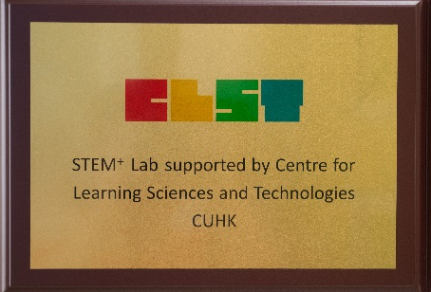
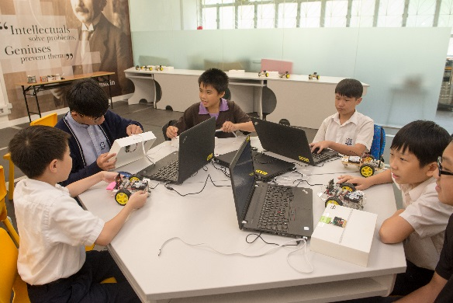
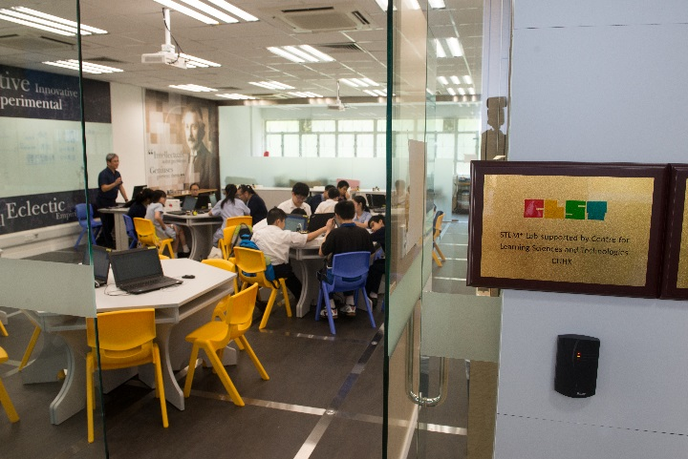
STEM-related Initiatives …
STEM⁺ LAB at Yu Kan Hing Sec. Sch.
STEM⁺ Education
any new educational initiatives grounded on STEM (e.g., STEAM, STREAM, Maker, etc.)
STEM x eLearning

